Slide 1
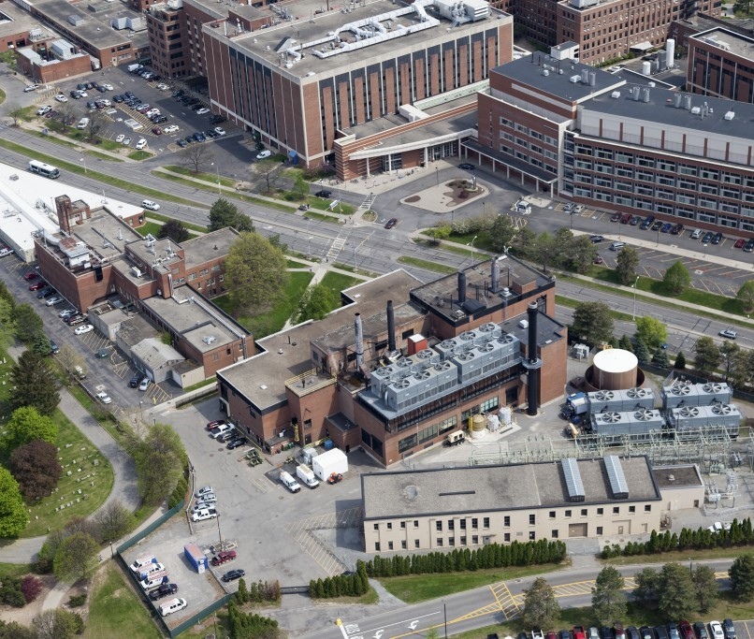
UEM PV Project
Beauclaire Mbanya Jr.

Slide 2
New York State Energy Portfolio
Notes:
Source: EPA- https://www.epa.gov/egrid/power-profiler#/NYUP

Slide 3
Solar Roof Analysis: How much electricity to be generated.
 | Total roof space (10³*ft²) | Solar DC System Size (10³*KW) | Cost of System (10⁶*$) | AC System Output (10⁶*KWh/Year) | 25 yr Output including PV degradation (10⁶*KWh)
Memorial Art Gallery | 40 | 0.5 | 1.1 | 0.6 | 15
South Campus | 190 | 2.6 | 5.2 | 3.0 | 72
Middle Campus | 20 | 0.2 | 0.4 | 0.2 | 5
Eastman | 70 | 0.9 | 1.8 | 1.1 | 25
River Campus | 450 | 6.2 | 12.5 | 7.4 | 176
Medical Center | 500 | 7.0 | 14.1 | 8.3 | 197
Total | 1,270 | 17.4 | 35.1 | 20.6 | 487

Slide 4
Solar Rooftop Potential

Slide 5
Solar Roof Analysis: Comments
FY18 CU energy data used for analysis.
System Size (KW) = Array Area (m²) × 1 KW/m² × Module Efficiency (15%)
PVWatts Calculator was used to determine AC System Output.
Solar roof space: Data from Sightlines, A Gordian Company presentation.
25 yrs. Output includes PV degradation: 2% Year 1 and 0.2% Years 2-25 (Solar Liberty Proposal).

Slide 6
GHG Emissions Reduction: PURCHASED ELECTRICITY
% GHG Reduction | Purchased Electricity (10⁶*KWh/yr) | GHG emission (10³*tons/yr) | GHG Savings (10³*tons/yr) | Solar PV - GHG Offset |  | Trees for GHG Offset
 |  |  |  | Solar DC Size (10³*KW) | Cost of System (10⁶*$) | Quantity (10³ Trees) | Cost of planting trees (10⁶*$)
0% | 148 | 18.7 | 0 | 0 | 0 | 0 | 0
1% | 147 | 18.5 | 0.2 | 1 | 2 | 7 | 11
2% | 145 | 18.4 | 0.4 | 2 | 5 | 15 | 22
5% | 141 | 17.8 | 0.9 | 6 | 12 | 37 | 56
10% | 133 | 16.9 | 1.9 | 11 | 23 | 75 | 112
15% | 126 | 15.9 | 2.8 | 17 | 35 | 112 | 169
20% | 118 | 15.0 | 3.7 | 17 | 35 | 150 | 225

Slide 7
Maximum Solar Rooftop Solar PV Investment
Fully Utilized PV Rooftop System Size is 17 MW at a cost of $35M.
25 year cumulative output = 4.87*10⁸ kWh over 25 years
Value of 25 year cumulative output = 4.87*10⁸ kWh x $0.06/kWh = $29.2M
25 year return rate on investment = value / cost = 29.2/35 = 0.834

Slide 8
25 Year Cumulative Annual Cashflow

Slide 9
Energy Comparison of ‘River Campus’ Peers
 | In Planning
 | Active
* | Purchasing Power Agreement

Slide 10
On-site Solar Comparison

Slide 11
On-site Wind Comparison

Slide 12
Green Energy Rating – Peer Colleges Comparison

Slide 13
Conclusion
If Solar roof capacity is fully used, it would meet 8.2% of the university’s electricity consumption.
262 acres of solar PV land space is required to meet all the university’s electricity needs.
Leveraging solar roof is valuable in decreasing GHG emissions. If fully capitalized, the maximum GHG from purchased electricity reduced by solar roof is 15%.
Solar PV does not greatly impact the %GP in the grid for the university when it replaces purchased electricity since the grid in NYUP is low carbon intensity. However, it is valuable when it replaces electricity generated from cogeneration as cogenerated electricity is produced with natural gas.
Further study is recommended to analyze the GHG from cogeneration, economics of the solar incorporation,

