Slide 1
HOW TO PURCHASE

Slide 2
REVIEW OF STEPS TO PLACING AN ORDER
Research the parts/service you need.
You need a work order number.
Create purchase requisition (preq).
Send any quotes, justification, etc. to Materials Management.
Once preq is approved and required paperwork verified, Materials Management will place the order.

Slide 3
BIGGEST MISCONCEPTION
That a preq means you have authority to order the part/have vendor come for service.
WRONG – a preq is a request to order the part or service. It still has to go through the approval process and get placed on a purchase order.
Violations of this policy mean that we must send the preq to the Director and then to the SAVP to sign along with a reason why the policy was not followed.
Exception is if it was an emergency.

Slide 4
APPROVAL LIMITS
Every employee has an approval limit in Famis
Mechanic, Administrative - $0
Supervisor/Planner Scheduler - $5,000
Manager - $25,000
Assistant Director/Business Manager - $100,000
Director - $250,000
SAVP - $500,000
Even after preq has been approved in Famis by all parties, if over $25,000 it still has to go through an approval process in Materials Management as a second check.

Slide 5
Emergency Vs Rush
Emergency
You had to call in a vendor for service or order the part without having a PO# first.
Example – a flood at night.
Preq must be done the next business day.
Rush
You need the part or service ordered right away.
Rush should be the first word in the description field on the preq line for each item so Materials Management knows to process it first.

Slide 6
GENERAL RULES REVIEW
1) Must have a PO# before ordering any part or service. You cannot verbally order something or use the preq# as your order (unless it is an emergency).
2) Have clear and complete description – i.e. do not just put “per quote” – must list details. If you have spoken to someone at the vendor, note it.
3) Cannot split job into multiple preq’s.
4) Must be an approved vendor.
5) Only one part per line on the preq.

Slide 7
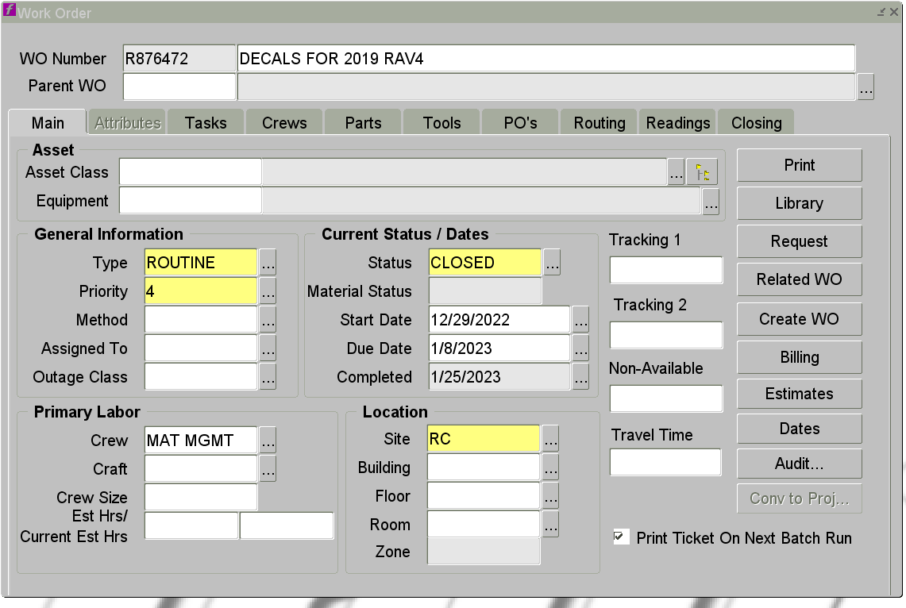
Creating A Preq
There are 2 options to get to the Purchase Requisition Form 1st - Start on work order form
Click on PO tab

Slide 8
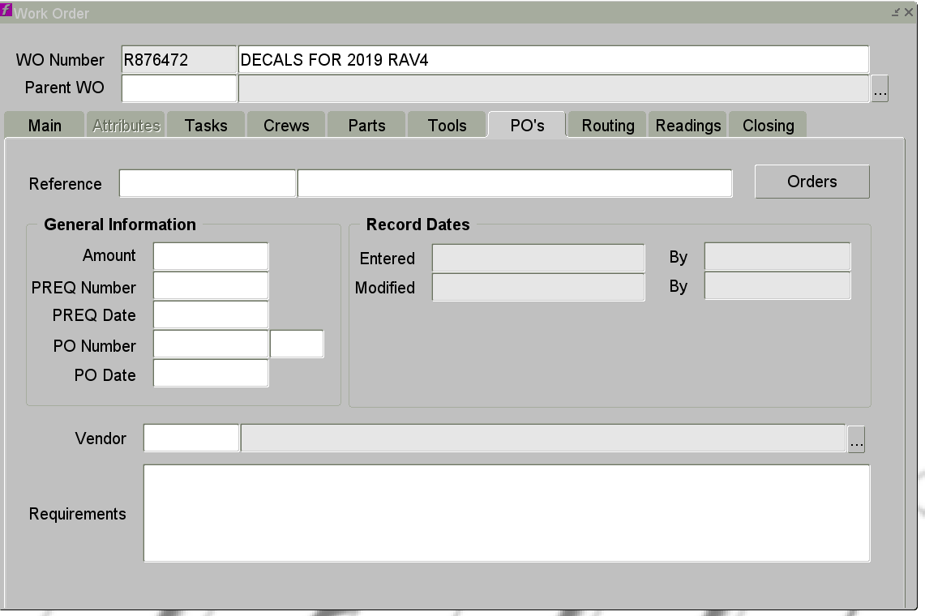
Click Orders Button

Slide 9
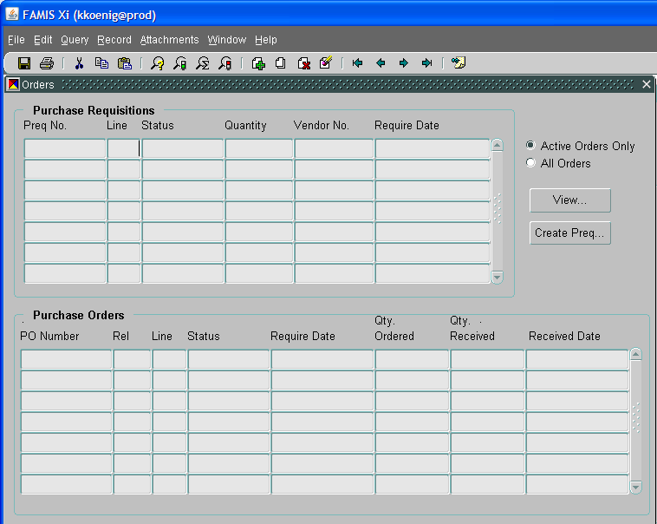
Click Create Preq

Slide 10
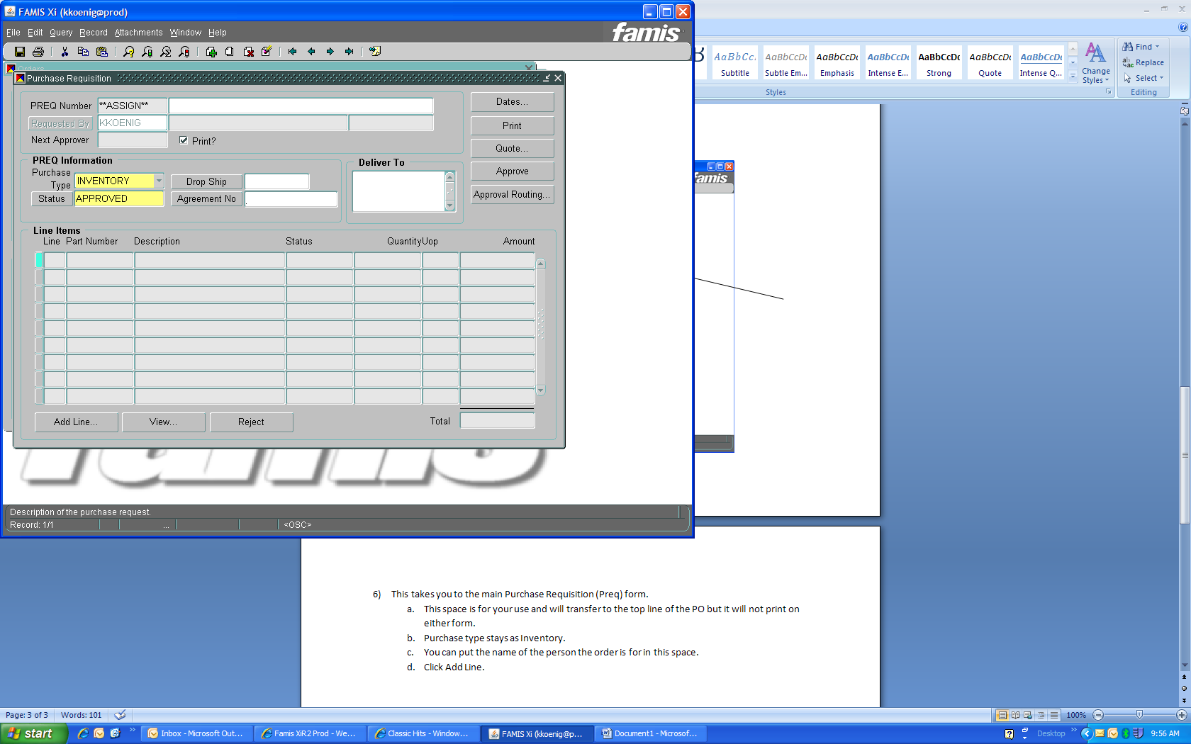
Preq Form
A
A ) Mandatory field Put a description of what the Preq is for. This will transfer to the top line of the PO, but it will not print on either form.
B) You can put the name of the person the order is for in this space.
C) Purchase type stays as Inventory.
D) Click Add Line.
C
B
D

Slide 11
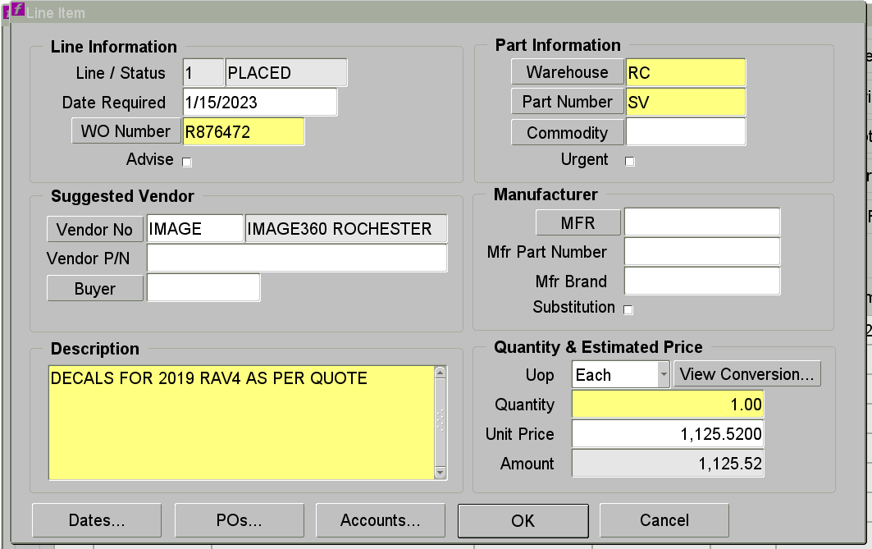
Preq Line Form
1
1) Line Information Fields
Fill in date needed by. Can type date or use F9 key to bring up calendar. Extra freight charges may be added to meet date.
If you started Preq from work order form, the WO# will fill in automatically. If you started from Preq, you will need to add WO# after you have added part number.
Advise checkbox does not work

Slide 12
Preq Line Form Continued
2
2) Part Information Field
Warehouse fills in automatically
Part numbers to use are:
MT or Material for parts
SV or Service for a vendor coming in to do service
Repair for items being sent out for repair or service (not on-site)
Capital is used at MC
CUMT is used at Central Utilities for material
CUSV is used at Central Utilities for service
Never use a stock part number
Commodity field is left blank
Urgent checkbox does not work

Slide 13
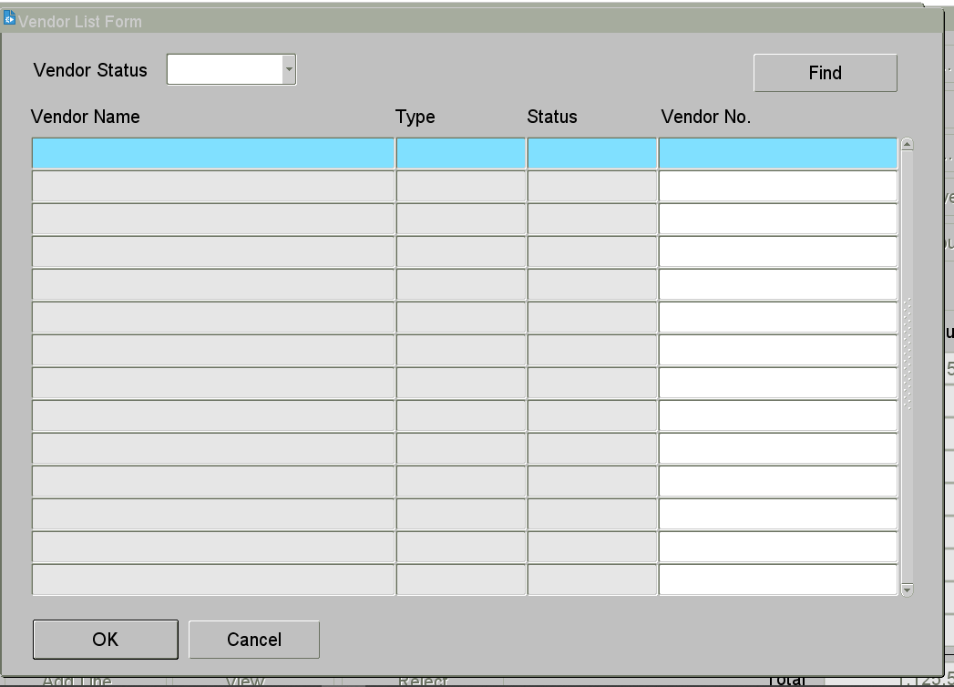
Preq Line Form Continued
3) Suggested Vendor Fields
Enter vendor code in Vendor No space
If you do not know the code, click the Vendor No box which brings up Vendor List Form.
Query: Enter part of vendor name with % sign before and after. This brings up list of all vendors that meet criteria. Select vendor you want – click OK.
Vendor P/N - Enter vendor part # if there is one
Leave Buyer field blank

Slide 14
Preq Line Form Continued
4
4) Manufacturer Fields
DO NOT USE MFR, MFR Part Number, or MFR Brand boxes
Put all MFG information in the Vendor P/N box and Description field
Substitution box does not work

Slide 15
Preq Line Form Continued
5) Description Field
Material: Full description of what the item is - manufacturer number, part number, specs, etc.
If ordering a case: List it here
Only one item per line
If it is a stock item in the warehouse: List the stock part number, but include a complete description
Service: List what is being done, where it is being done, when the work will take place, and a contact at the company.
If applicable list “Emergency” or “Rush” as first word.
5

Slide 16
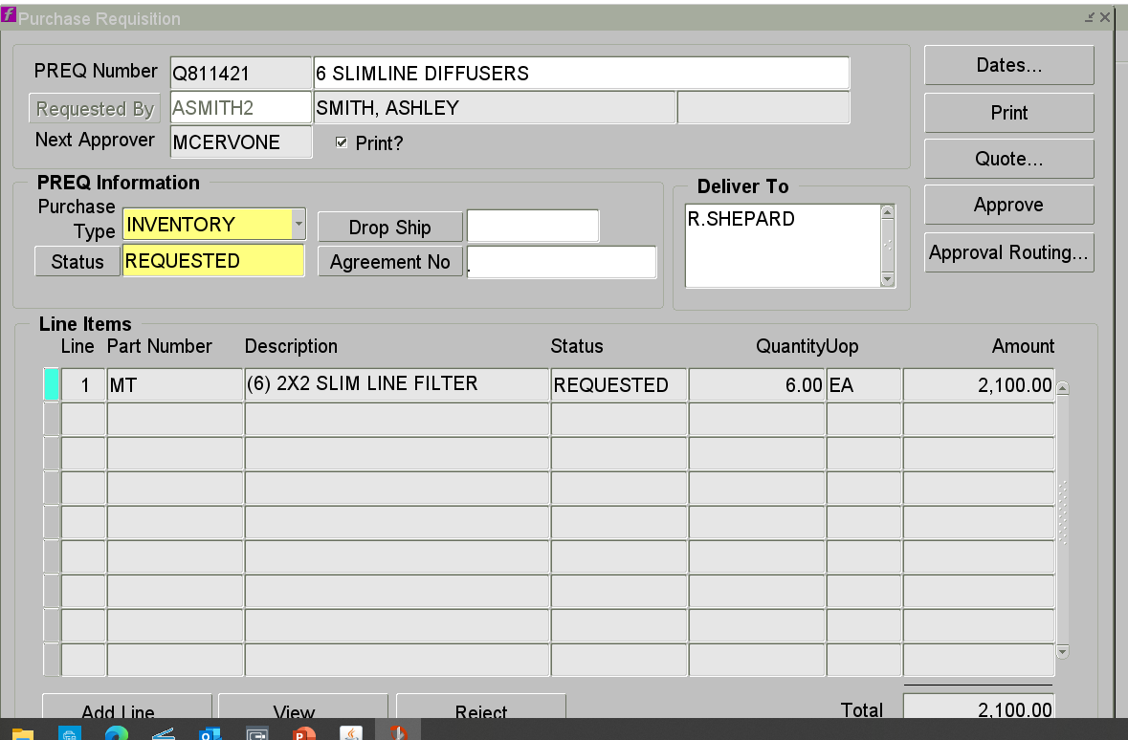
Preq Form Completing
A) If adding another line, click Add Line button
B) The status will be either Requested or Approved, depending on your dollar limit
C) If Preq is in Requested status, the next approver’s name is listed under your name
C
B
A

Slide 17
Second method to create a preq
Start directly on the Preq form
Mechanic’s Bench – Parts – Purchase Req
Supervisor’s Bench – Purchasing – Purchase Req
This method must be used for standing work orders
Work order number must be filled in on each line

Slide 18
Things To Remember
Vendors do not have access to the work order# or preq#. So don’t contact vendor looking for update on your order with either of these numbers.
The information put next to the preq# does not transfer to the PO.
One part# per line. We need to receive each item as it comes in.

Slide 19
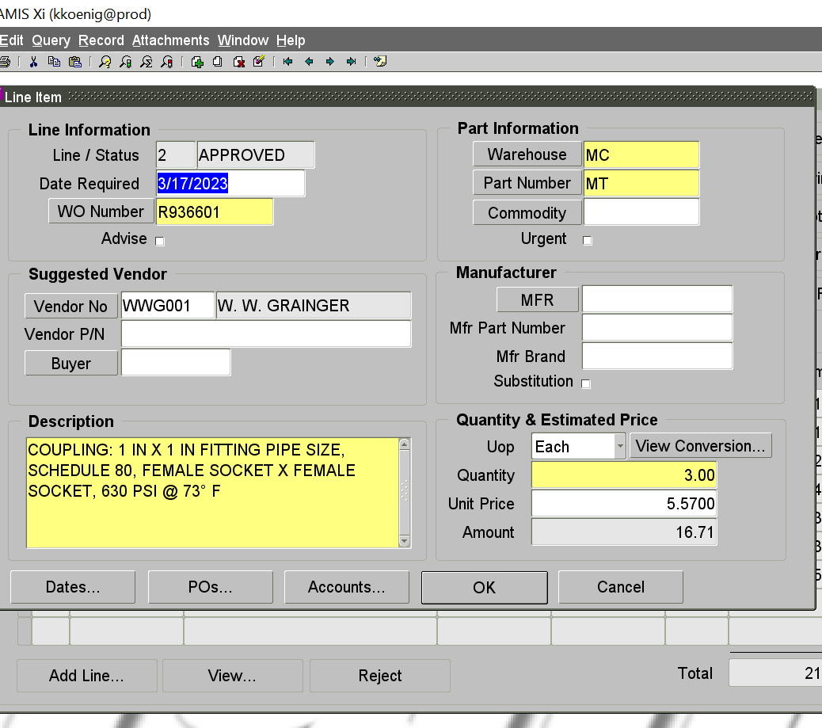
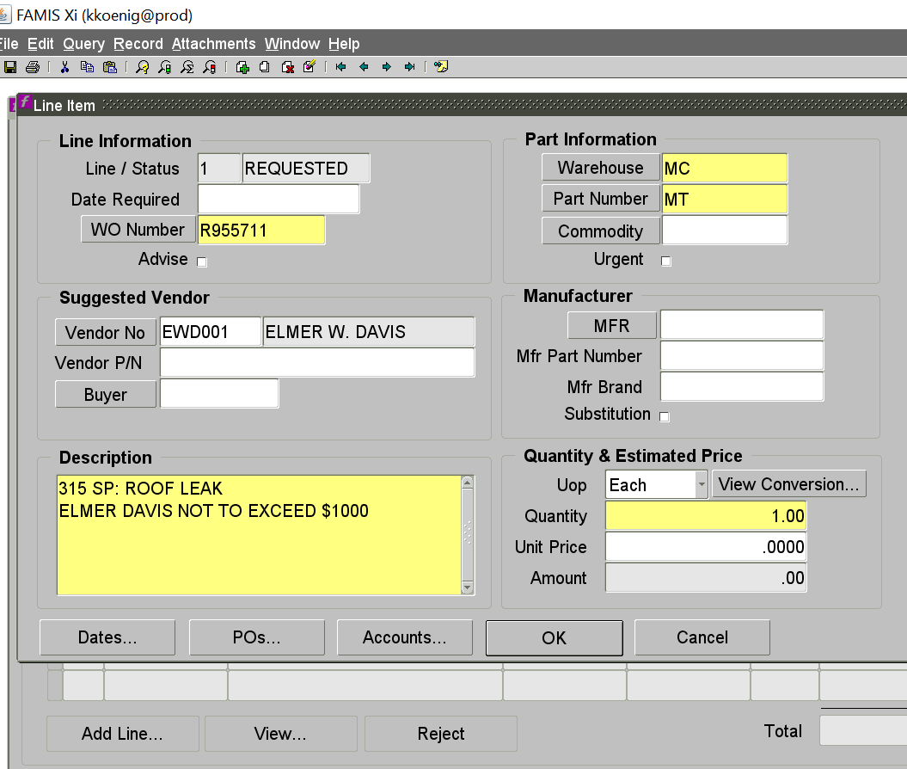
Examples of incorrect preq’s
No vendor part# listed
No price listed in unit price field

Slide 20
What paperwork is required?
Any service requires a quote. If scope of work not known then use not to exceed (NTE) amount but be as accurate as possible.
Material orders under $1,000 generally do not require a quote but if specialty item you should have one.
Under $25,000 only one quote needed.
Over $25,000– three quotes required. If did not get 3 quotes, then be ready to explain why.
Over $25,000 also requires 2 forms - (SPJCI) Supplier Price Justification and Conflict Information form and the Additional Justification form.
All paperwork needs to be emailed to our 402 email boxes – 402mc, 402rc or 402cu depending on your location.

Slide 21
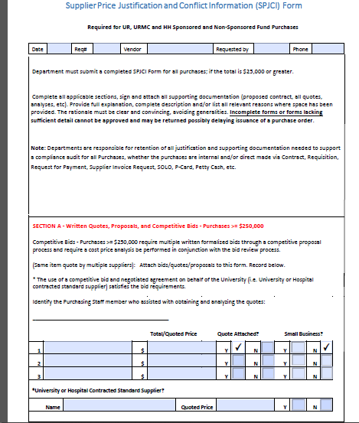
Supplier Price Justification & Conflict Information
Section A – bids
University or Hospital Contracted Supplier – vendors negotiated by Corporate Purchasing for University-wide contracts - not necessary to have other bids when using these vendors:
Champion Moving
Otis Elevator
Waste Management
Wesco

Slide 22
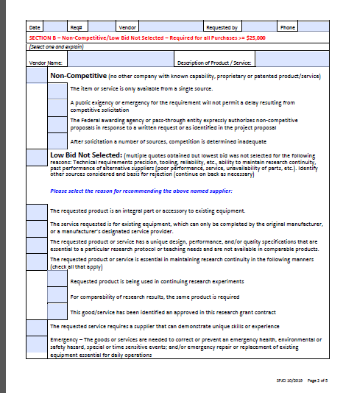
SPJCI Page 2
Section B – If did not get competitive bids, then fill out top section.
If low bid not selected then check all boxes that apply in next section.

Slide 23
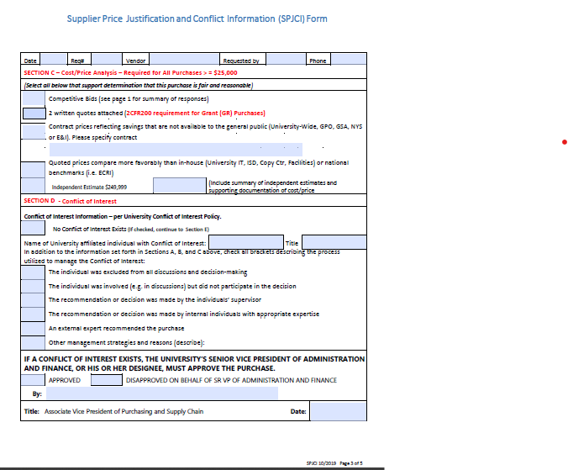
SPJCI Page 3
Section C – check if got competitive bids, or pricing is NYS contract or University-wide contract or if is better pricing than doing in-house.
Section D – verify there is no conflict of interest

Slide 24
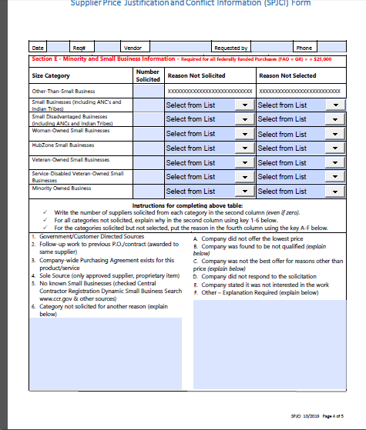
SPJCI Page 4
For minority and small business. Fill out as applicable

Slide 25
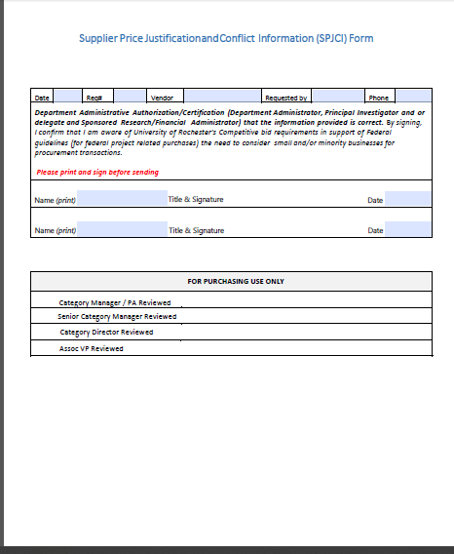
SPJCI page 5
Requestor has to sign
If any of the following apply, then appropriate Director has to sign as well:
3 bids but lowest bid not selected.
Less than 3 bids

Slide 26
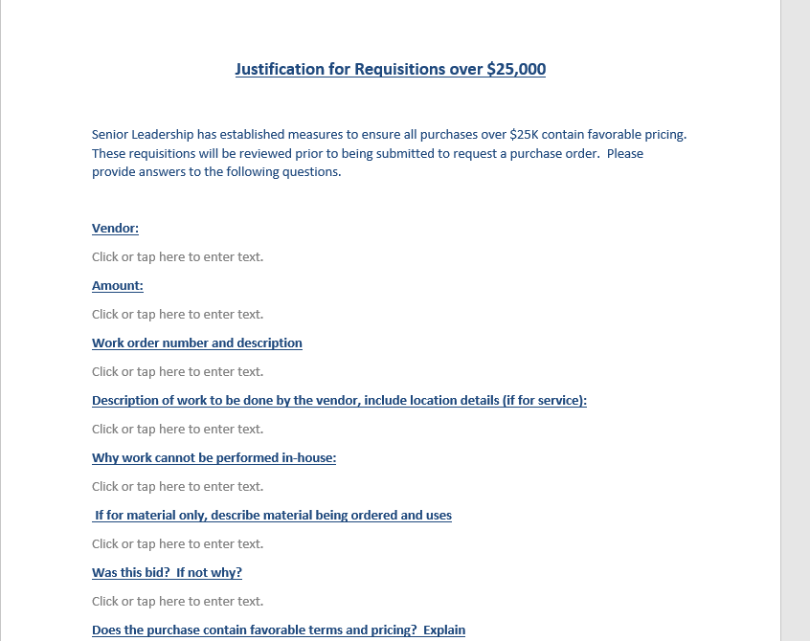
Additional Justification Form

Slide 27
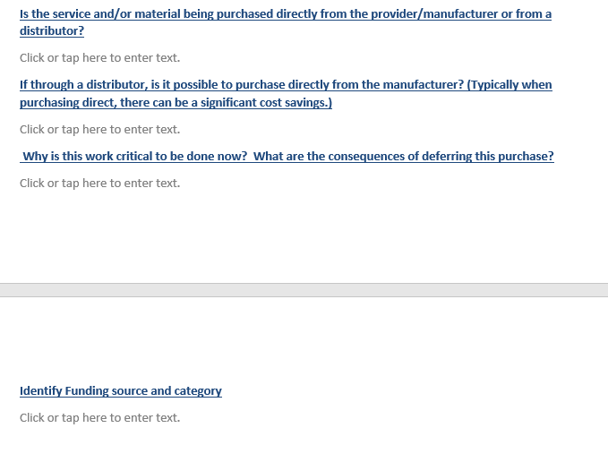
Additional Justification Form

Slide 28
What happens next?
There are 3 types of purchase orders that Materials Management can issue:
An “I” PO
A Standing PO
A PO through Corporate Purchasing

Slide 29
Types of Purchase Orders
I purchase order
PO# is 6 digits followed by –I
Can only be for material or for a repair being done offsite up to $1,000. Cannot be for service.
PO# can be given right away.

Slide 30
Standing PO
For vendors used frequently, we set up a SPO through Corporate Purchasing for a not to exceed amount and specific time period.
For jobs under $5,000 each. Can be for material or for service.
PO can be issued right away, as long as we have not gone over our PO total. Is issued as a release number against the standing PO number.

Slide 31
Purchasing PO
If we can’t do a SPO or an “I” PO then we have to do a req to Corporate Purchasing through Procure to Pay (P2P) system.
Depending on their workload and the vendor status this can take anywhere from a couple days to several weeks to get a PO issued.
If you keep having to wait for this type of PO for a particular vendor, you need to let us know so we can set up a SPO with them.
Some material vendors have a catalogue in P2P and we are required to go through P2P for these vendors – McMaster Carr, Grainger are examples. These PO’s usually issued fairly quickly.

Slide 32
Preq/PO status
Preq
Requested – still needs to be approved by someone
Approved – preq is approved and with Materials Management to process
Placed – preq has been turned into a purchase order
Purchase Order
Open – PO has been sent to vendor and waiting for confirmation
Placed – PO has been confirmed by vendor with pricing and delivery date
Complete – PO has been received

Slide 33
WHAT HAPPENS IF?
A job is quoted and preq/PO created but then additional work is added resulting in a higher price:
A new preq must be done for the new total amount. Current PO#/rel# should be referenced in the preq.
This ensures that the preq goes through the correct approval process.
If the original job was over $25,000 or the new total results in the job going over this amount then a new justification form must be done as well.

Slide 34
WHAT HAPPENS IF?
Preq/PO was done for a not to exceed amount (NTE) and when the invoice comes in it is higher?
If the amount is less than $500 higher you do not need to do anything. (I.E. PO for $1,000, invoice for $1,400).
If the amount is more than $500 higher, then a new preq must be done for the new total amount. (I.E. PO for $1,000, invoice for $2,000) Please reference the current PO#/rel# in your preq.

Slide 35
WHAT HAPPENS IF?
PO done for various parts but requestor orders another part that is not on PO without doing a preq.
Preq must be done for the new part before it can be picked up.
You don’t know how to do a preq – can someone in Materials Management do it for you?
Sorry we are not allowed to do preqs for anyone else. It needs to go through the appropriate approval process.

Slide 36
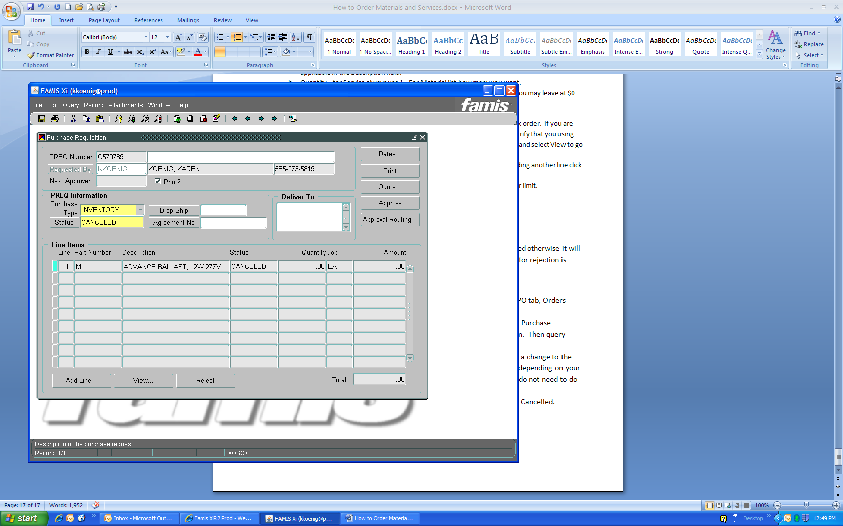
Rejected Preqs
If a Preq is rejected, it must either be corrected or cancelled:
To correct: Query the Preq# and click View Line. Make your changes to the description, price, etc. Preq will automatically go back to Materials Management or to Supervisor for approval.
To cancel: Change status on Preq form to Canceled If Famis won’t let you cancel then let us know and we can.

Slide 37
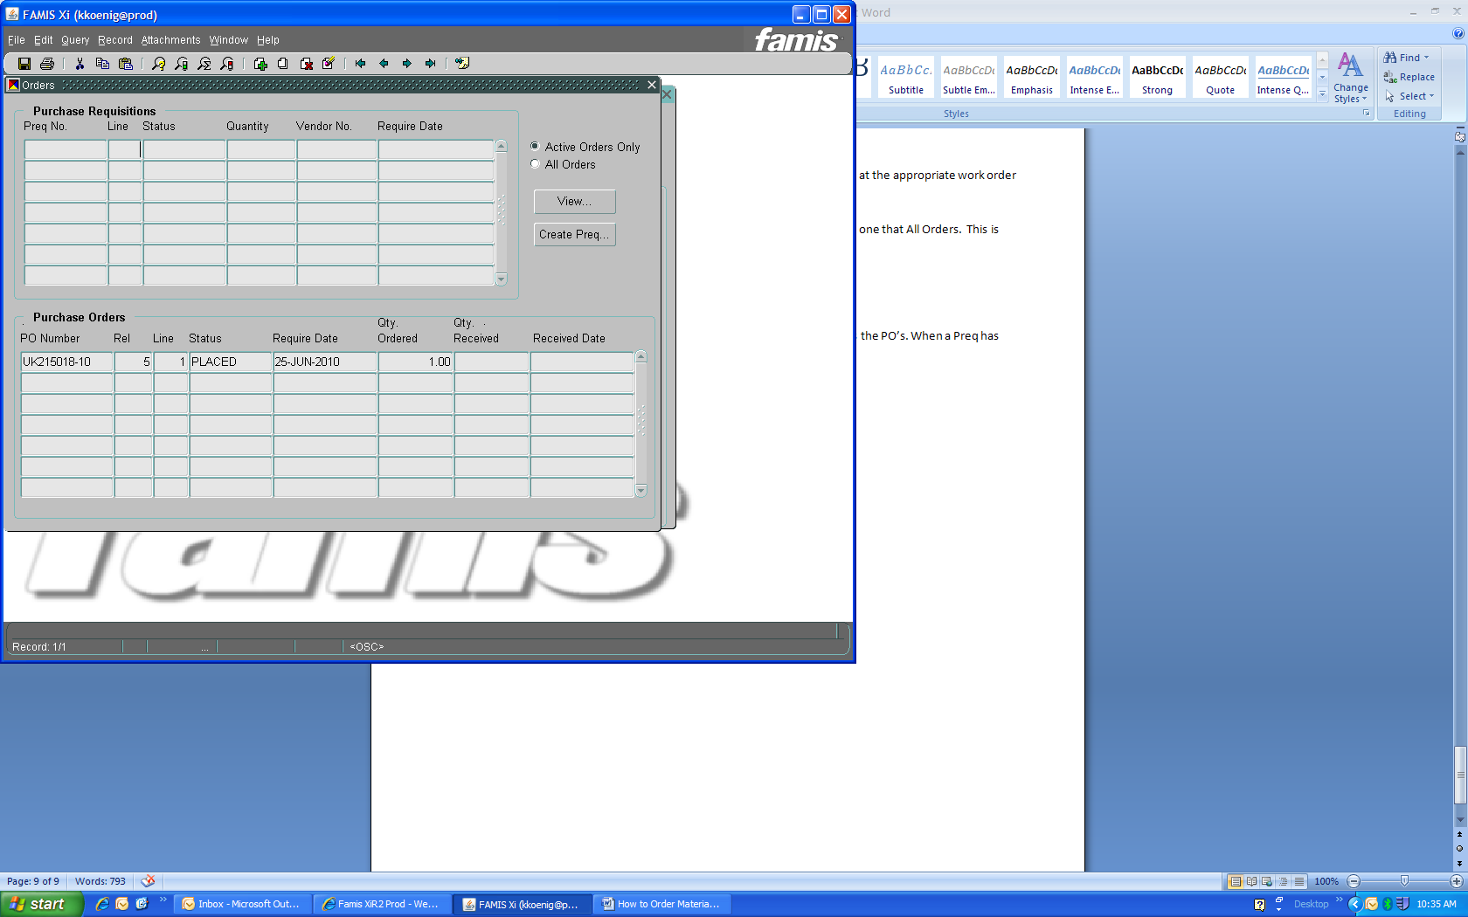
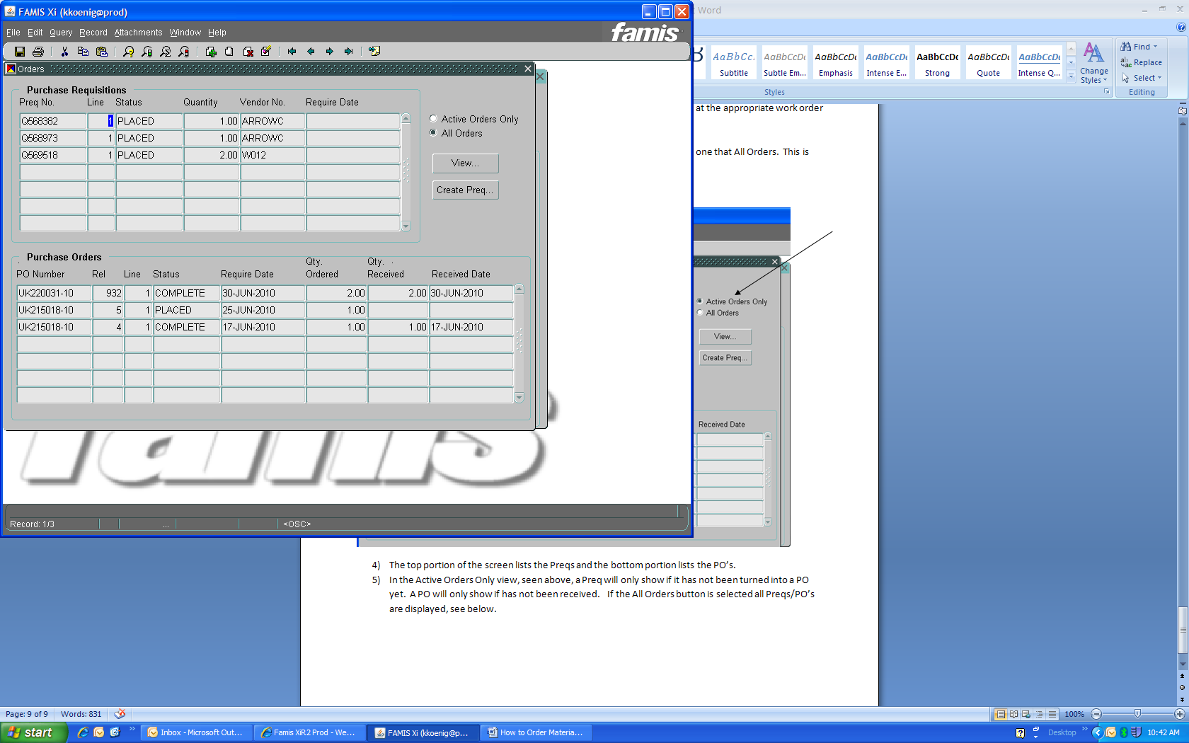
Tracking Your Order
1) Start at work order form to find status of Preq, delivery dates, or pricing. Continue as if creating new Preq until you get to Orders form.
2) There are two views: One shows Active Orders, and the other shows All Orders. Top portion lists Preq’s, bottom portion list PO’s.
3) In the Active Orders Only view, a Preq will only show if it has not been turned into a PO. A PO will only show if it has not been closed out yet.
4) To view a Preq, click on that line and click the View button.

Slide 38
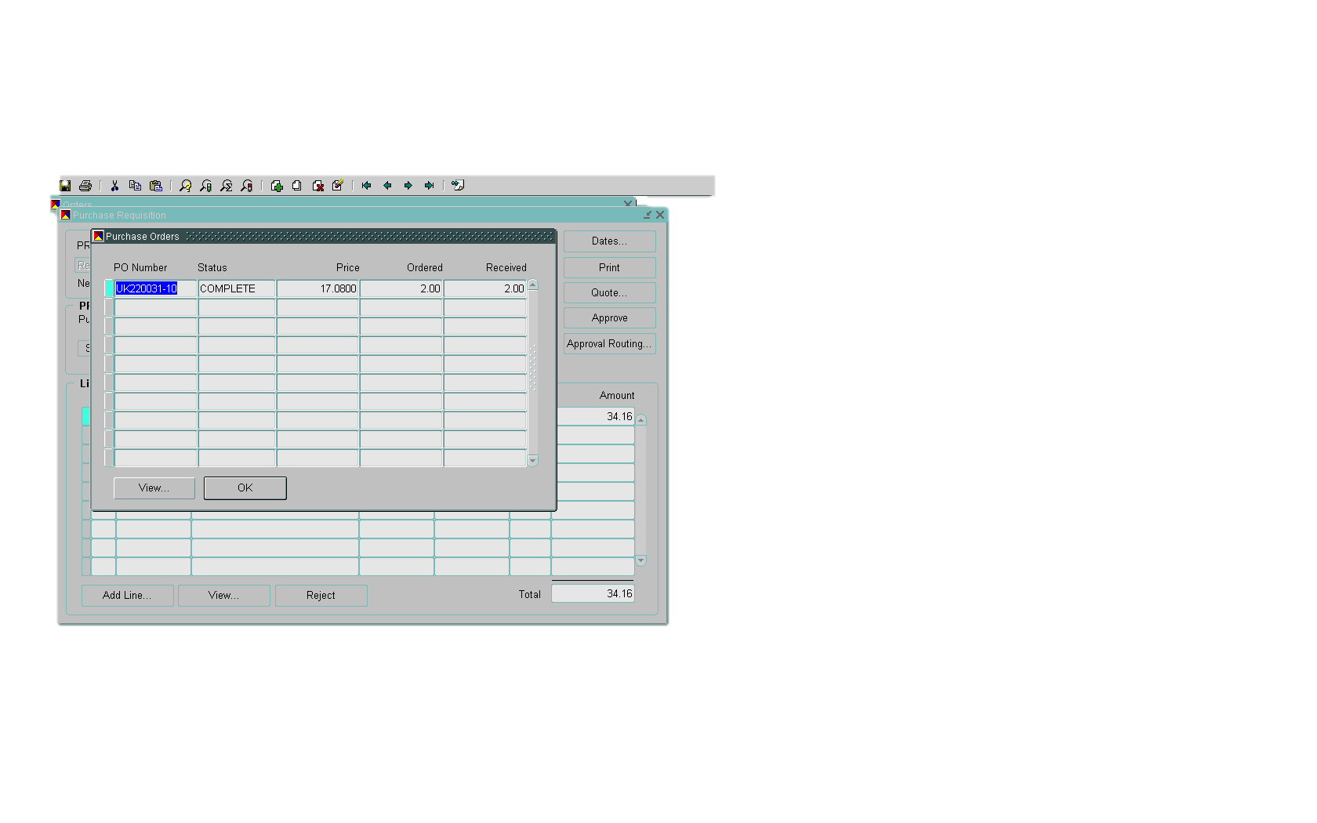
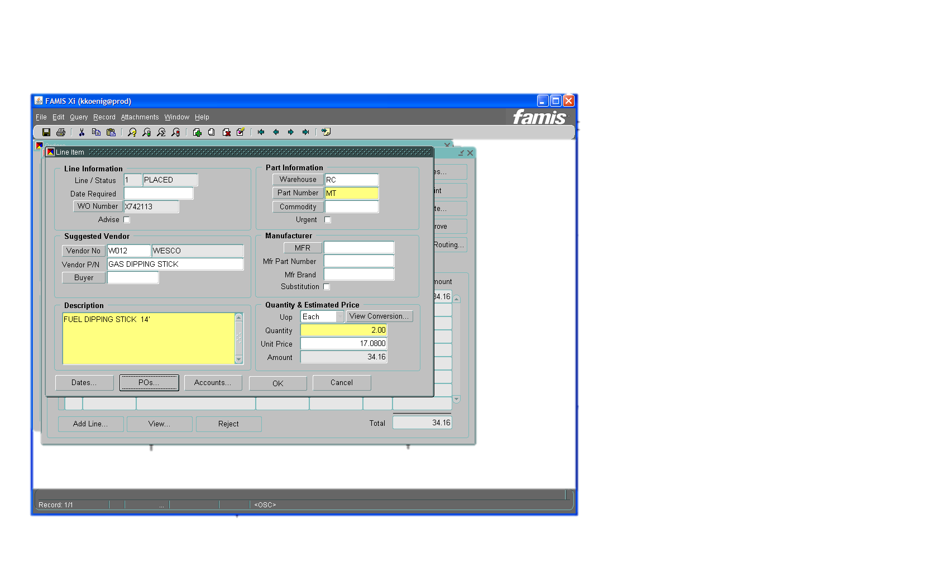
Tracking Your Order Continued
This takes you to Preq line form. Click PO button at bottom.
If Preq has been turned into a PO it is listed here. Click view button.

Slide 39
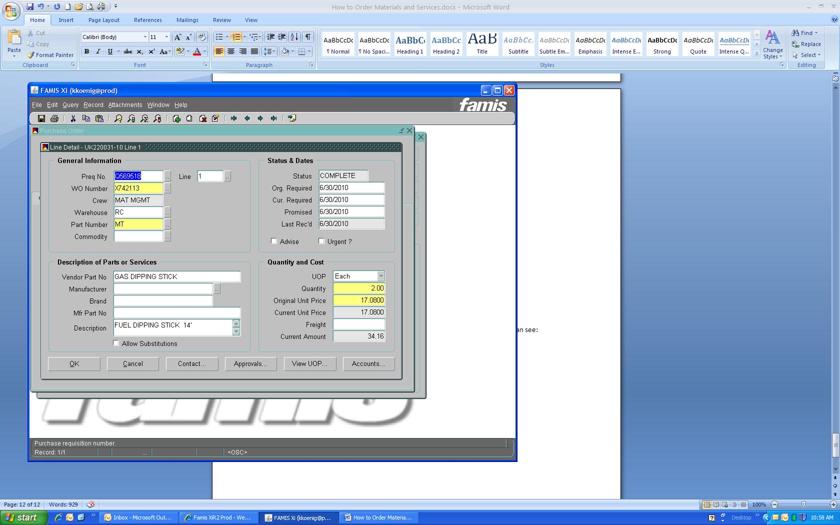
Tracking Your Order Continued
This takes you to PO Line form
A) Status of the order
B) Confirmed delivery date (use Cur Required)
C) Confirmed price
Click OK button and will go to PO page where you can see PO# and release# (if there is one)
A
B
C

Slide 40
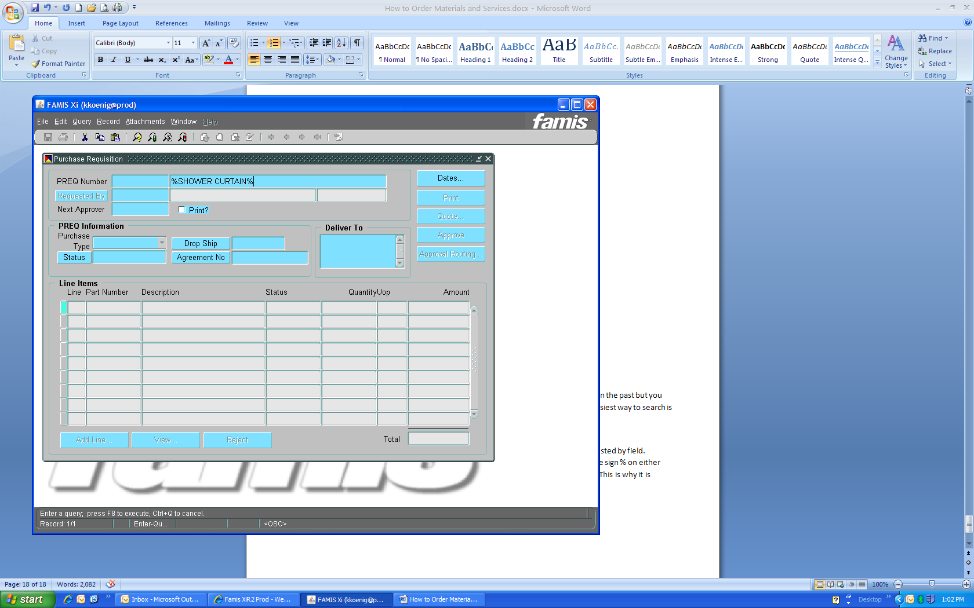
Finding Previous Order Information
2
3
To research previous orders that you or someone else placed, open a blank Preq and enter query mode
Put name of person who placed Preq in Requested By box
Put partial description in field with % sign before and after
Once query is executed, use arrow keys to scroll through all Preq’s
This procedure also works on the PO form
1

Slide 41
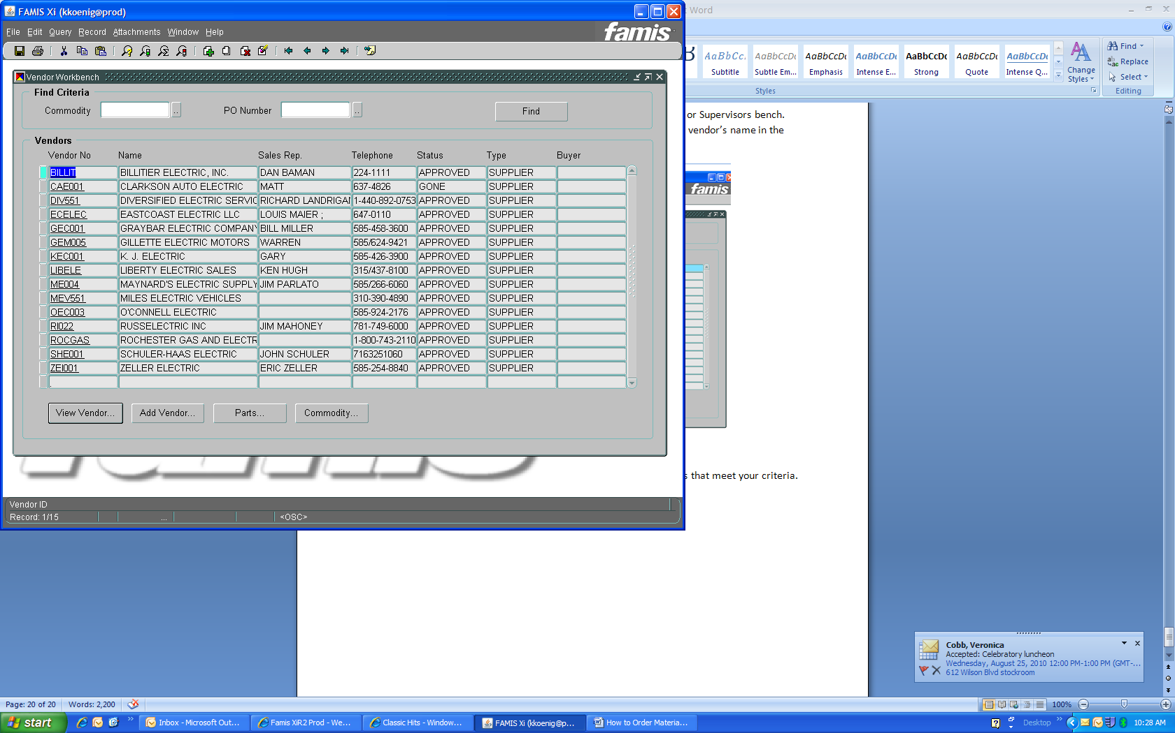
Vendor Workbench
To research a vendor: Start on the Vendor Workbench form, located in the Parts folder
Query the vendor name, using % sign to see list of vendors.
To see more information on a vendor, click View Vendor button to go to the Vendor form

Slide 42
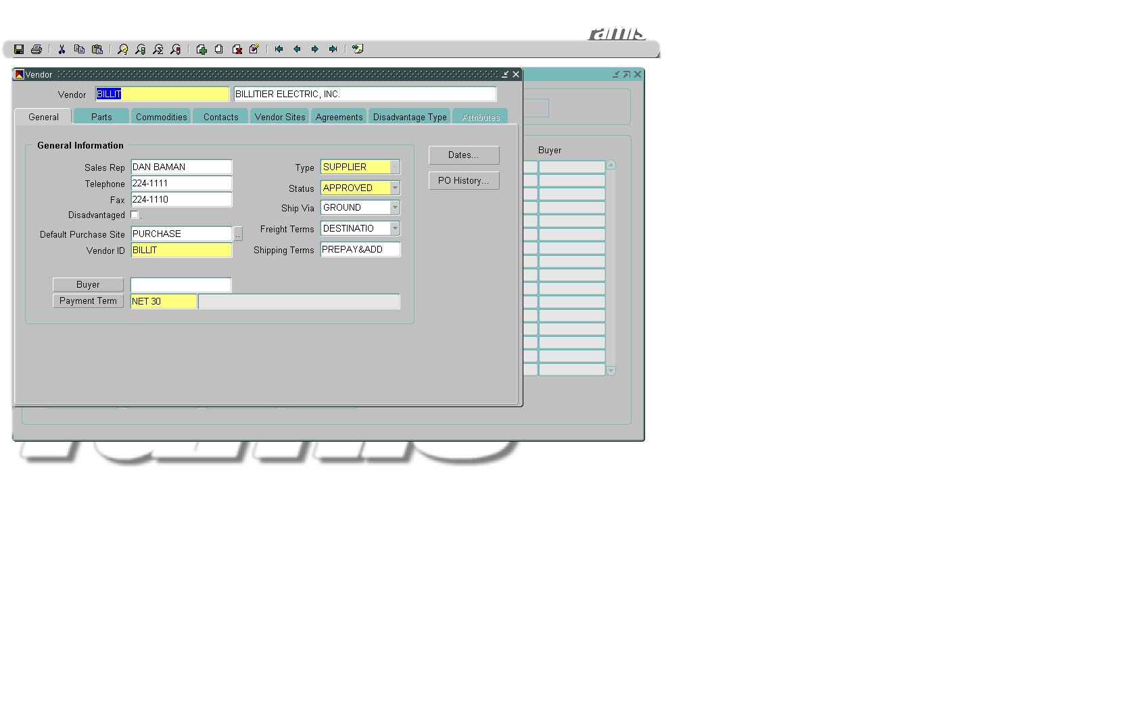
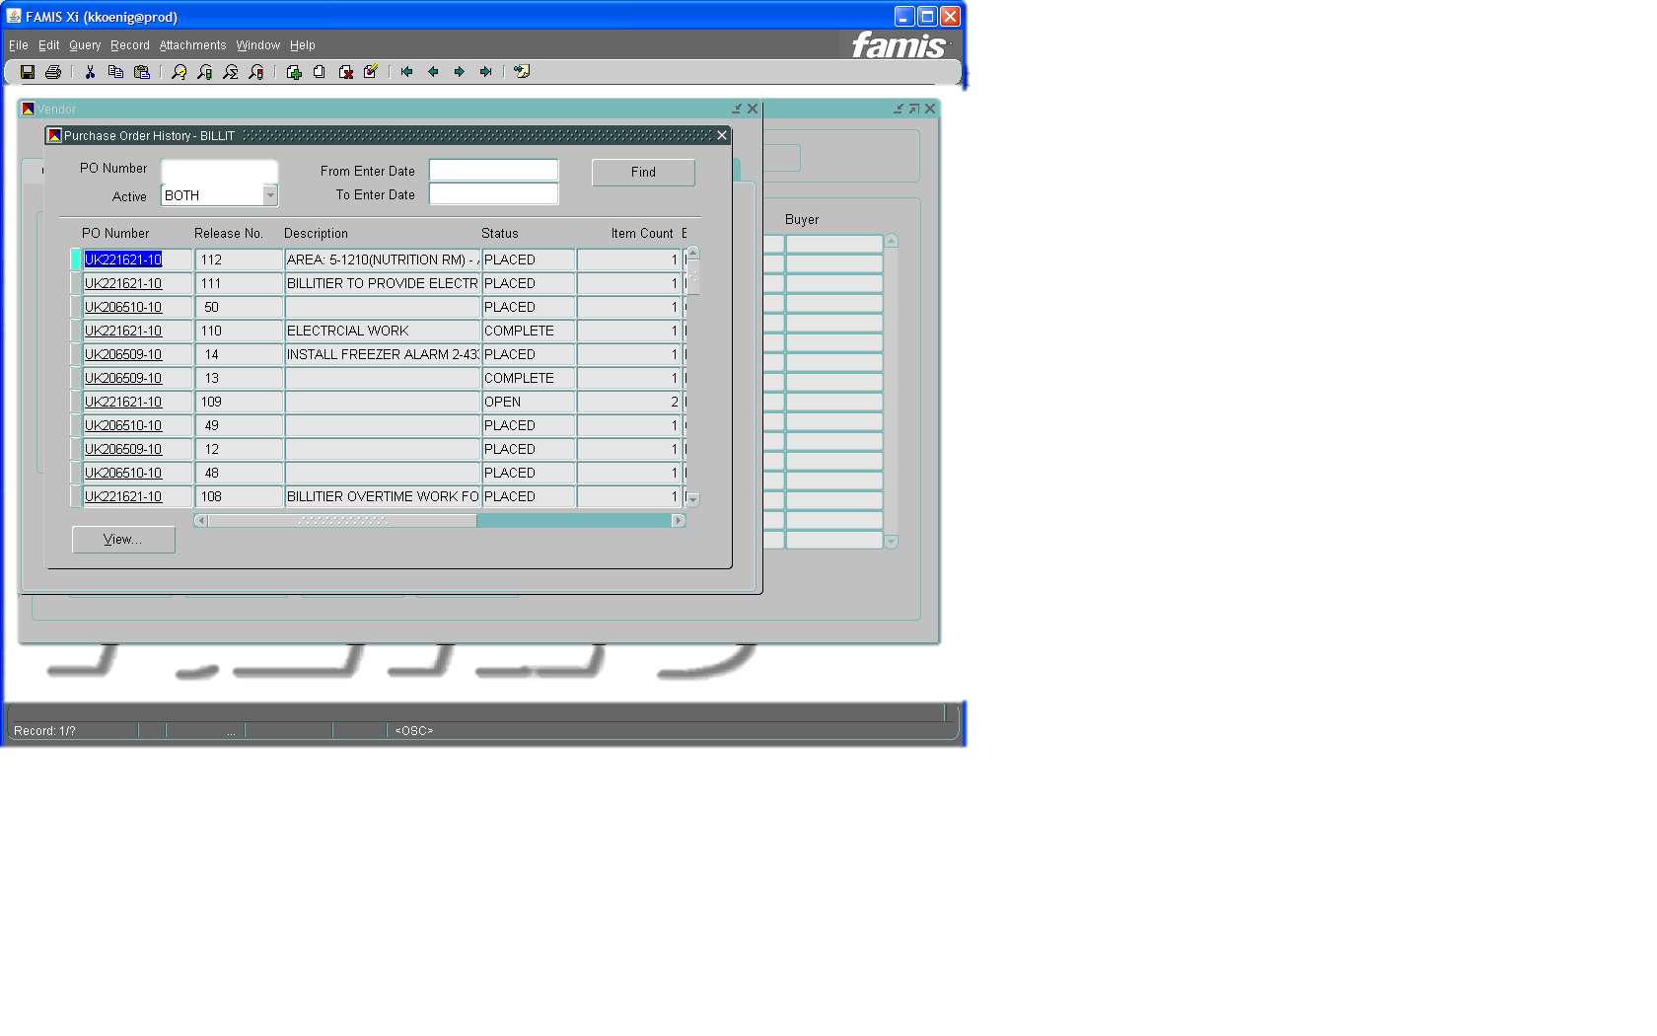
Vendor Form
Vendor Sites tab shows address
To see list of PO’s, click PO History
button and then click Find button on form
To see further information on a PO click the PO line and click View button to go to PO form

Slide 43
Invoice Approval
Any job based on Time & Material rates will be reviewed by the Financial Transactions Administrator to verify correct rates are being charged versus vendor’s quoted rates/markup.
It is the Requestor’s responsibility to ensure that the number of hours and/or days worked are accurate and the material charged is appropriate for the job done.

Slide 44
Vendor Invoice Communication
Letter will be sent to all vendors annually
Vendors may not start work without a valid PO#.
Send all invoices to UF&S Materials Management, not Finance Accounts Payable.
Invoice must include all required backup documentation – labor timesheets, material invoices, equipment rental invoices, mark-up, and subcontractor invoices, all as required.
Do not proceed with any work or ordering of materials (adjustments/increases to PO) without appropriate PO amendment.
Invoices must be sent in a timely manner.
Fuel surcharges are not allowed.
Partial invoices must be billed monthly.
The University reserves the right to audit each vendor.
Each vendor must adhere to University of Rochester Terms & Conditions.
The University maintains a Fraud hotline 275-1609. Anonymous reports may be made to Integrity Hotline at 756-8888.

Slide 45
Monthly Report
Will be sent to UF&S Management
Report will show on a tab for MC, RC & CU: requestor, vendor, preq dollar amount and preq description
It is responsibility of management to review report.
Second tab for each site on report shows number of open work orders
CREW | REQUESTOR | PREQ TOTAL | APPROVED BY | PREQ NO | ENTER DATE | WO NUMBER | VENDOR | PREQ DESCRIPTION
CTSBBM | MSYDOW | $95.16 | RHIBBARD | Q632534 | 01/03/2014 | Z580992 | WESCO | BOLLARD ANCHOR BASE
CTSBBM | MSYDOW | $103.88 | RHIBBARD | Q632694 | 01/08/2014 | Z472883 | WESCO | MOP HANDLE AND HEADS
CTSBBM | MSYDOW | $75.95 | RHIBBARD | Q633061 | 01/15/2014 | Z472883 | WESCO | FLASHLIGHT
CTSBBM | MSYDOW | $207.40 | RHIBBARD | Q633513 | 01/23/2014 | Z580992 | WESCO | BOLLARD BASE
CTSBBM | MSYDOW | $92.92 | RHIBBARD | Q633594 | 01/24/2014 | Z472883 | WESCO | AMERICAN PADLOCKS
 | MSYDOW Total | $575.31
CTSBBM Total |  | $575.31
CTSBSP | DSCHERMER | $354.88 | DSCHERMER | Q633163 | 01/16/2014 | Z534229 | WESCO | TEE
CTSBSP | DSCHERMER | $1,350.00 | DSCHERMER | Q633222 | 01/17/2014 | Z552023 | POSTLER & JAECKLE | R WING 6" WATER MAIN REPLACMENT (INVESTIGATE)
 | DSCHERMER Total | $1,704.88
CTSBSP | MCCAPITAL | $1,750.00 | TFLEMING | Q633258 | 01/17/2014 | Z553547 | POSTLER & JAECKLE | SRB1418A - L/M TO INSTALL FLAPPER ON DRAIN PIPE
 | MCCAPITAL Total | $1,750.00
CTSBSP Total |  | $3,454.88
DATACTR | DBARRY | $168.00 | SPAOLINI | Q632916 | 01/13/2014 | Z596139 | WARREN'S PAINT & DECORATING | DATA CENTER
 | DBARRY Total | $168.00
DATACTR | DSCHERMER | $200.00 | DSCHERMER | Q632373 | 12/30/2013 | Z511909 | WESCO | PRO PRESS UNION PRO PRESS TO NPTE
 | DSCHERMER Total | $200.00
DATACTR | JPACITTO | $500.00 | RPANIK | Q632914 | 01/13/2014 | Z596486 | DAVIS-ULMER SPRINKLER CO., INC | SDC - DE-ACTIVATE FIRE SUPPRESSION SYSTEM 1-27-14
DATACTR | JPACITTO | $622.20 | RPANIK | Q633081 | 01/15/2014 | Z597630 | WESCO | REPLACE BATHROOM FANS IN WOMANS ROOM (X2)
DATACTR | JPACITTO | $250.00 | RPANIK | Q633145 | 01/16/2014 | Z598054 | DAVIS-ULMER SPRINKLER CO., INC | DAVIS ULMER CALLED IN FOR FIRE PANEL RESET
DATACTR | JPACITTO | $6,465.00 | WPOTEAT | Q633169 | 01/16/2014 | Z598212 | WESCO | PURCHASE ALBER BATTERY CELL RECORDER
DATACTR | JPACITTO | $254.72 | RPANIK | Q633287 | 01/20/2014 | Z599270 | WESCO | PURCHASE SPARE FUSES
DATACTR | JPACITTO | $2,500.00 | STEUGEMAN | Q633474 | 01/22/2014 | Z601115 | RUSSELECTRIC INC | EMERGENCY REPAIR CALL IN TO RUSSELECTRIC

Slide 46
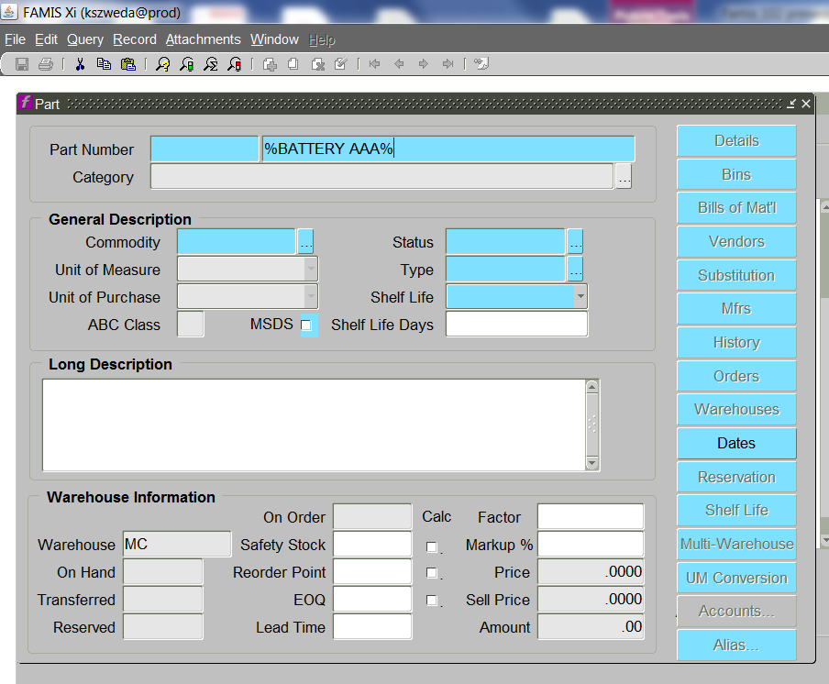
Stock Parts – what is stocked and where to find it
Can search Parts screen in Famis or use on-line Parts Catalogue
To use Famis, go to Parts and query description

Slide 47
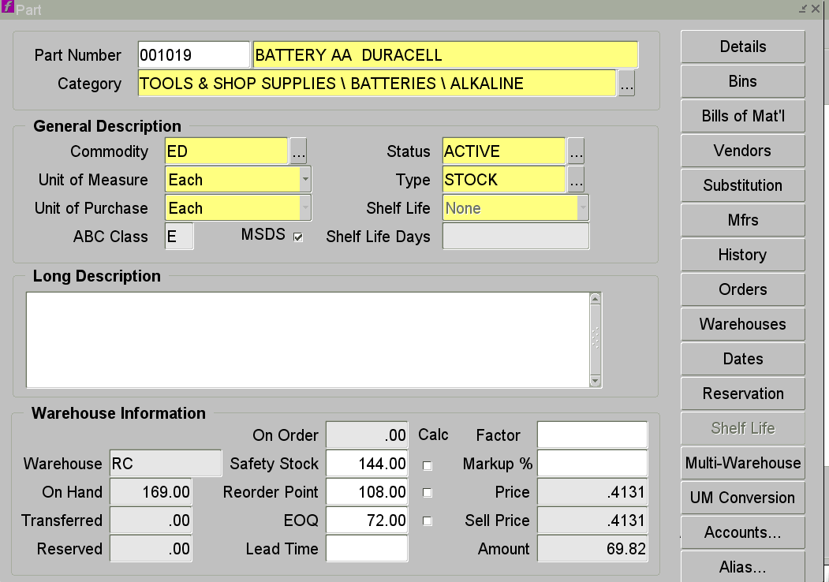
Parts Form
On Hand – shows how many in stock
Reorder Point – when goes below this number it orders the quantity listed in EOQ
Price – amount you will be charged.

Slide 48
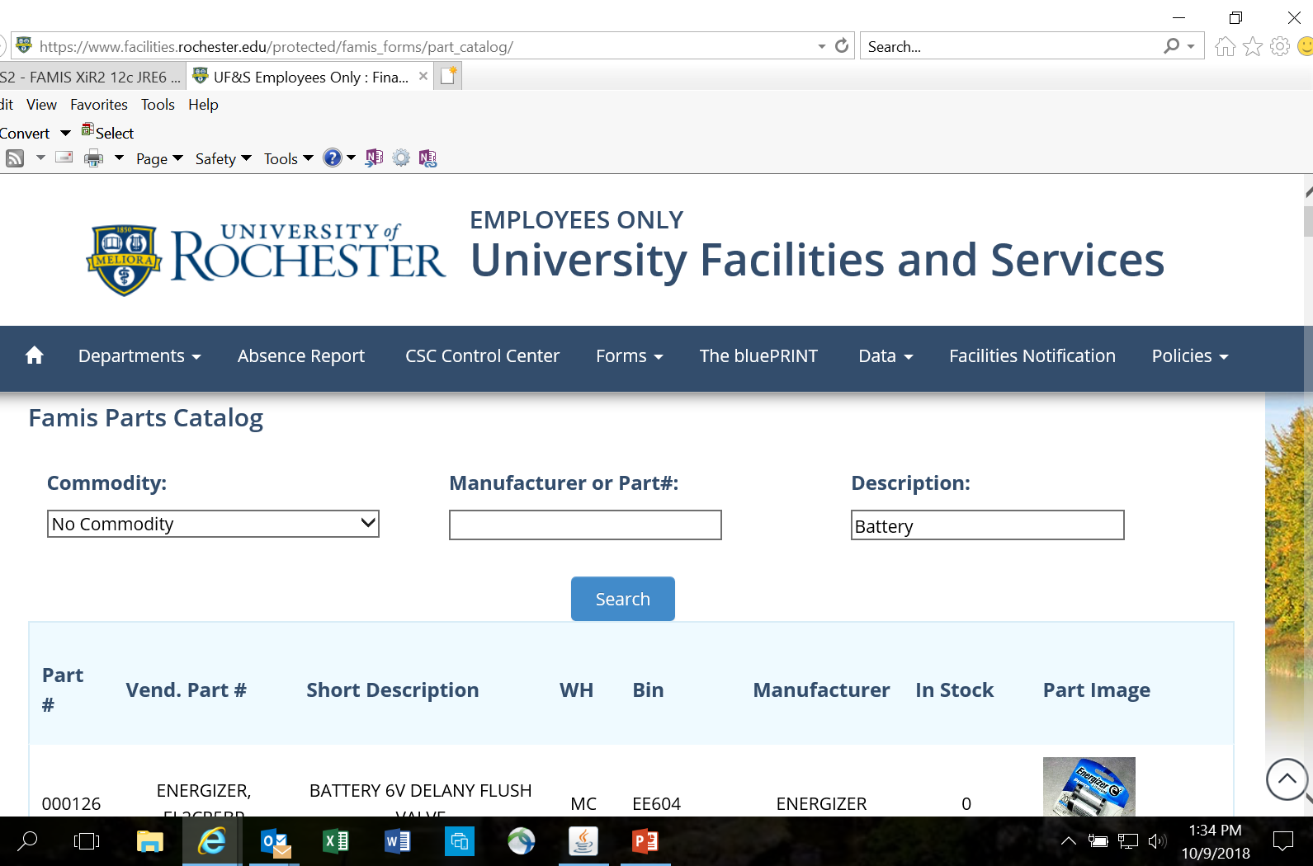
Parts Catalogue
http://www.facilities.rochester.edu/protected/famis_forms/part_catalog/

Slide 49
Stocking a new part
Driven by the Requestors
New Equipment that requires maintenance parts
Equipment Upgrades
New Buildings
Something you find you are ordering frequently through the Spot Buy Process
http://www.facilities.rochester.edu/support_ops/document/StockPartUpdate_05.15.pdf
Notes:
Paper Form can be obtained from Stock keepers

Slide 50
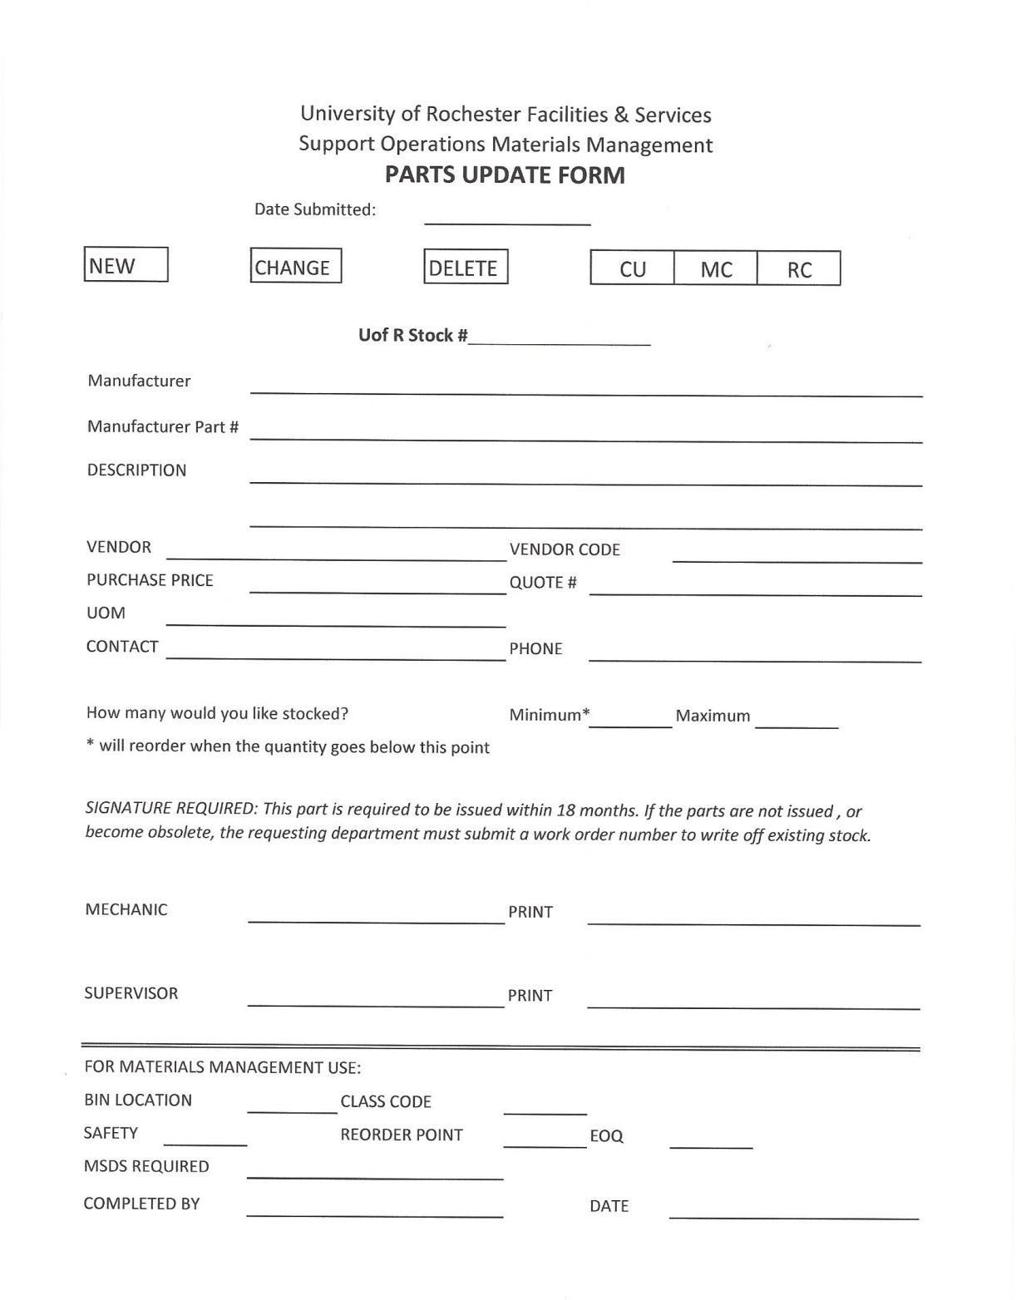

Slide 51
Questions?

